Slide 1

Workshop 3 Presentation: Implementation of Portenta H7 based CAN Bus Simulation & Fault Injection Tool
Nguyen dang tien loi - 21009

Slide 2
Tool Specifications
- CAN Bus Simulation:
  Classic CAN
  Bit rate 250000
- Fault Injection
  Manipulating Parameters
  Adding Delay
  Ignore

Slide 3
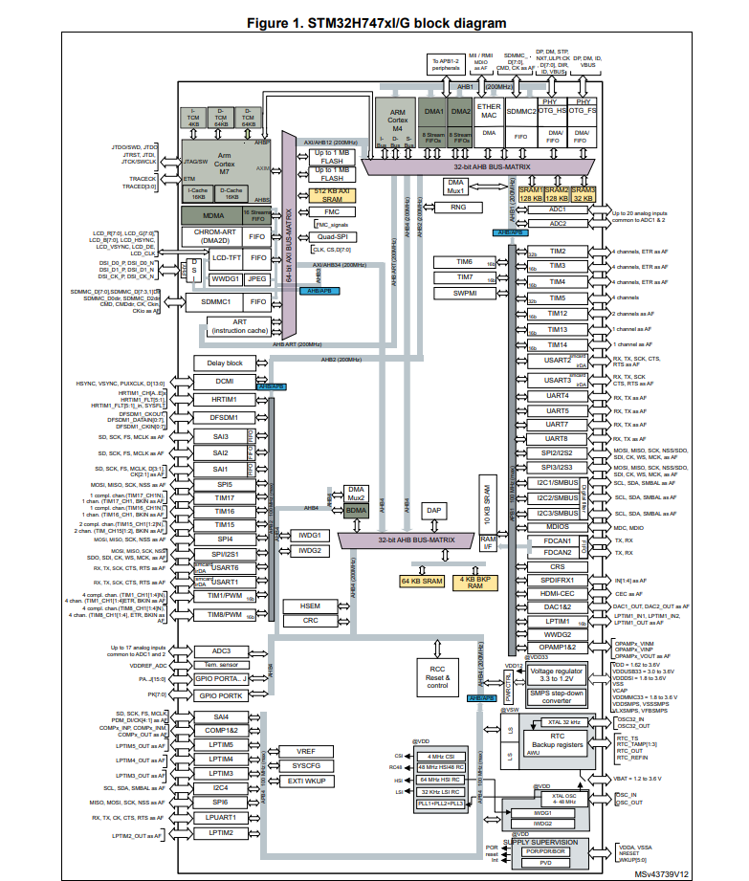
Micro controller
Source: (2)

Slide 4
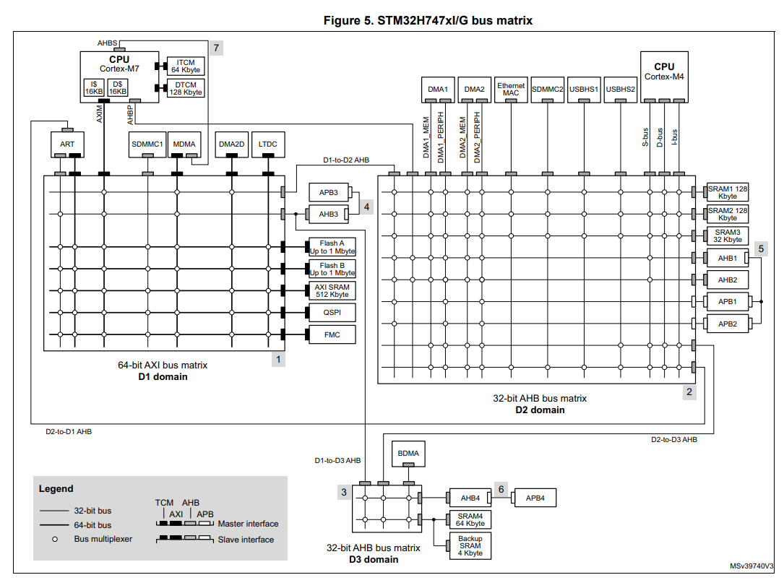
Bus Matrix
Source: (2)

Slide 5
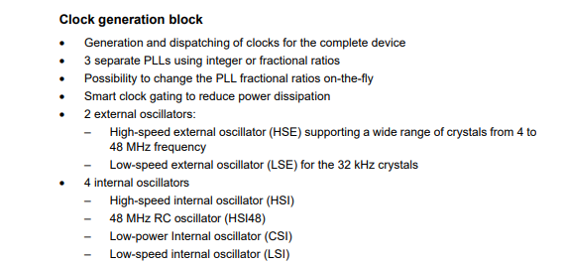
Clock generation block
Source: (3)

Slide 6
Arduino Setup
Magic Number (validation): a0
Bootloader version: 22
Clock source: External oscillator
USB Speed: USB 2.0/Hi-Speed (480 Mbps)
Has Ethernet: Yes
Has WiFi module: Yes
RAM size: 8 MB
QSPI size: 16 MB
Has Video output: Yes
Has Crypto chip: Yes
Linker Script at /home/tienloi/.arduino15/packages/arduino/hardware/mbed_portenta/2.3.1/variants/PORTENTA_H7_M7/linker_script.ld
Vector Table at /home/tienloi/.arduino15/packages/arduino/hardware/mbed_portenta/2.3.1/cores/arduino/mbed/targets/TARGET_STM/TARGET_STM32H7/STM32Cube_FW/CMSIS/stm32h747xx.h

Slide 7
FDCAN Implementation
- CAN Pin: PB_8, PH_13 (CAN0)
- Clock Source: PLL
- Enable TimestampCounter & TimeoutCounter
- IT: RX_FIFO0_NEW_MSG, TIMEOUT_OCCURRED, TIMESTAMP_WRAPAROUND, TX_COMPLETE
https://github.com/meomotminh/CAN-HAL/blob/main/HAL CAN/CAN INIT/CAN_Init/src/FDCAN/FDCAN.cpp

Slide 8
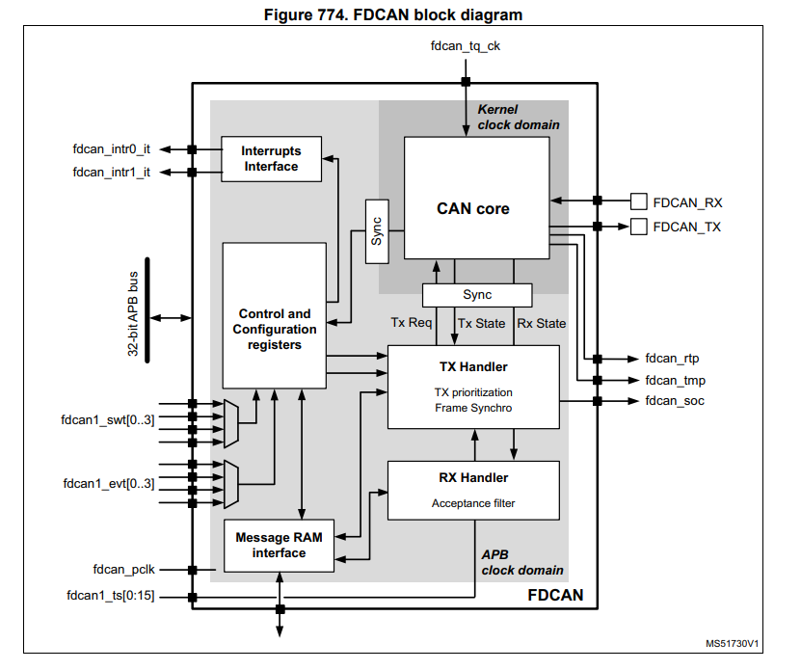
FDCAN peripheral
Source: (3)

Slide 9
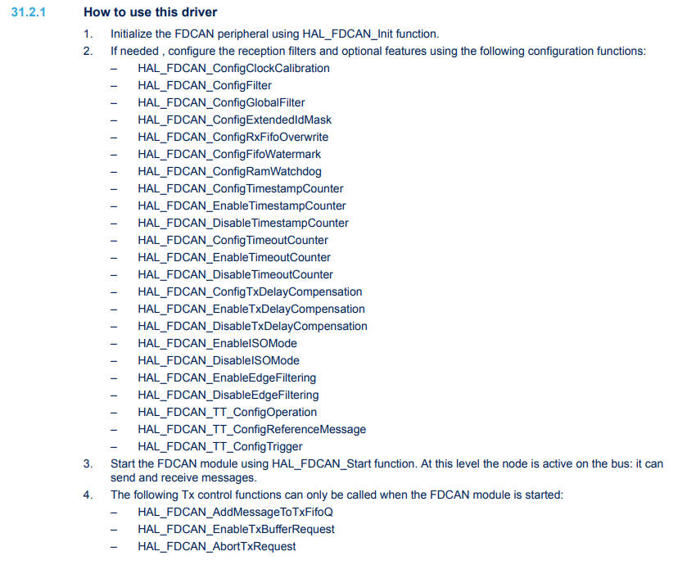
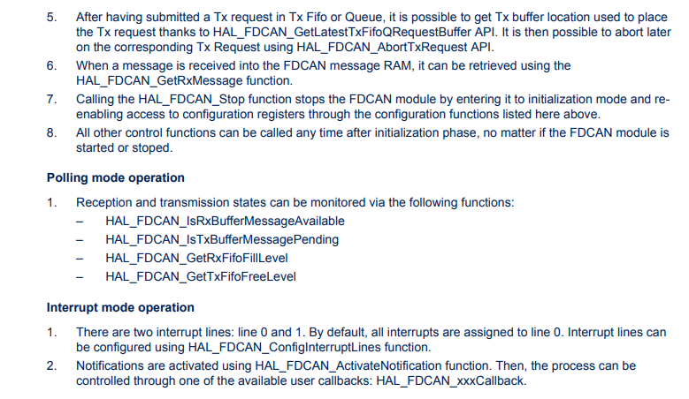
FDCAN HAL Instruction
Source: (1)

Slide 10
FDCAN Implementation
- CAN Pin: PB_8, PH_13 (CAN0)
- Clock Source: PLL
- Enable TimestampCounter & TimeoutCounter
- IT: RX_FIFO0_NEW_MSG, TIMEOUT_OCCURRED, TIMESTAMP_WRAPAROUND, TX_COMPLETE
https://github.com/meomotminh/CAN-HAL/blob/main/HAL CAN/CAN INIT/CAN_Init/src/FDCAN/FDCAN.cpp

Slide 11
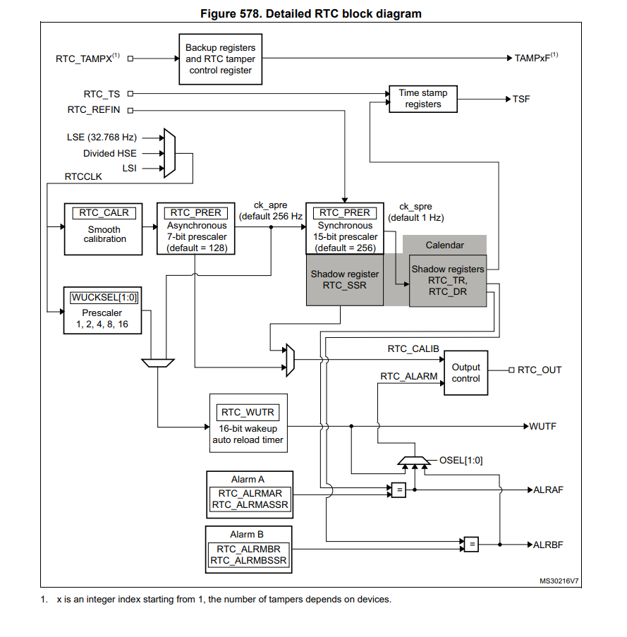
RTC peripheral
Source: (3)

Slide 12
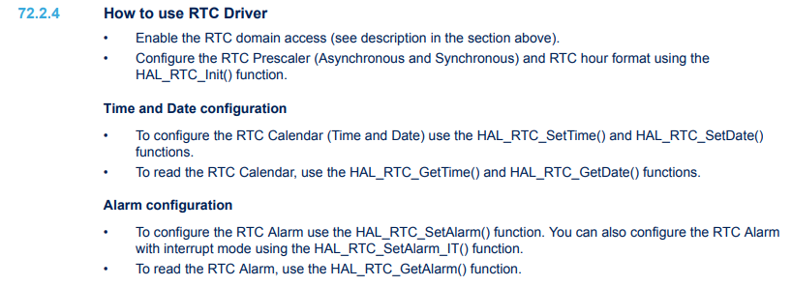
RTC HAL Instruction
Source: (1)

Slide 13
RTC Implementation
- HourFormat: 24
- Set Time: 12:45:00
- Set Date: 12 June 2018 (Tuesday)
- Clock Source: LSE
- Enable EXTI Line 17 for RTC Alarm
- IT: RTC_Alarm
https://github.com/meomotminh/CAN-HAL/blob/main/HAL CAN/CAN INIT/CAN_Init/src/RTC/RTC.cpp

Slide 14
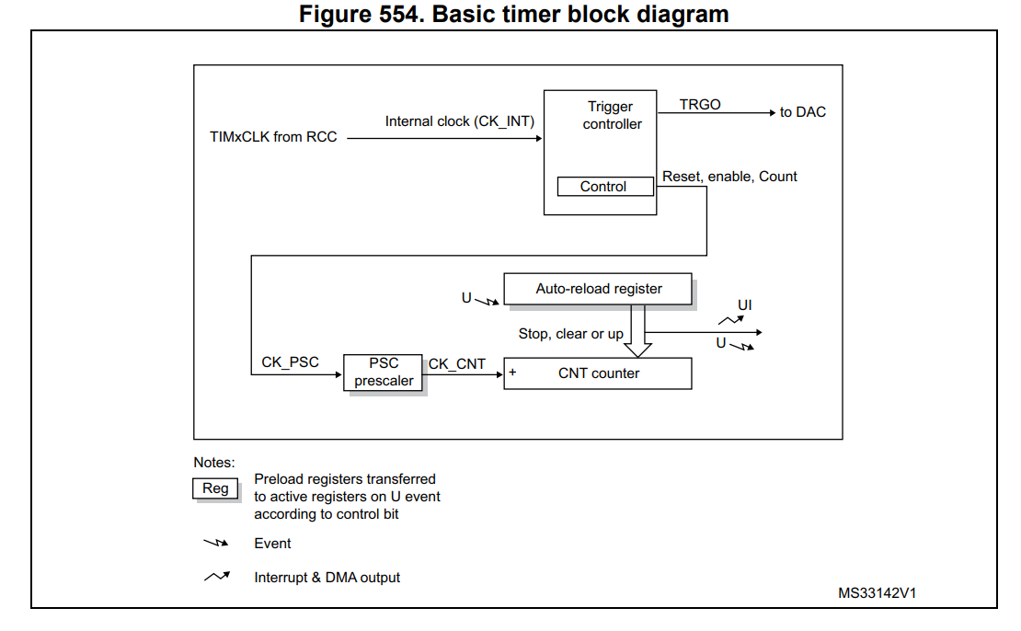
TIMER peripheral
Source: (3)

Slide 15
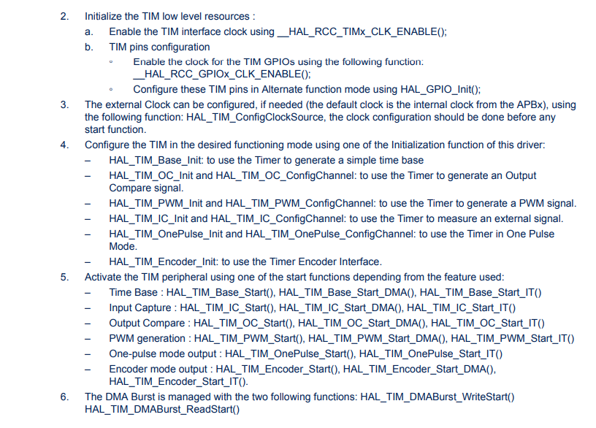
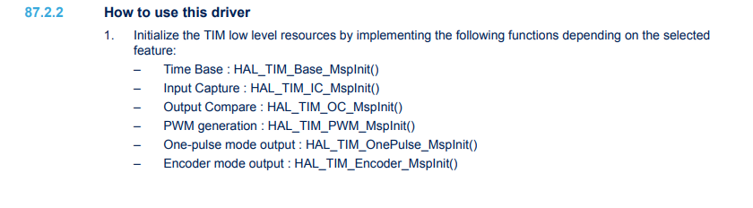
TIMER HAL Instruction
Source: (1)

Slide 16
TIMER Implementation
- Timer 6
- Bus APB1
- Period : TIM6CLK / 1000
- IT: TIM6_DAC
https://github.com/meomotminh/CAN-HAL/blob/main/HAL CAN/CAN INIT/CAN_Init/CAN_Init.ino

Slide 17
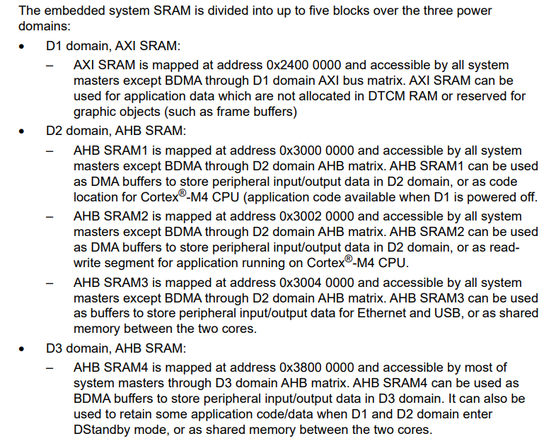
SRAM
Source: (3)

Slide 18
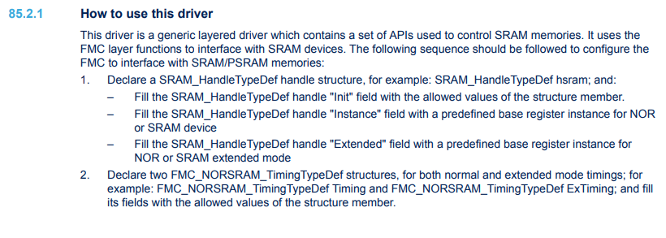
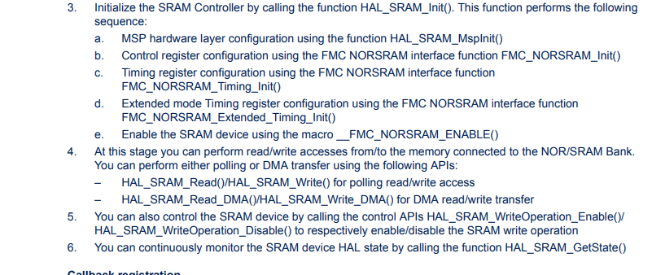
SRAM HAL Instruction
Source: (1)

Slide 19
SRAM Implementation
- SRAM1
- Config FMC_NORSTAM_BANK1 (not used)
https://github.com/meomotminh/CAN-HAL/blob/main/HAL CAN/CAN INIT/CAN_Init/src/loiTruck/loiTruck.h

Slide 20
Fault Injection Workflow
- Read Scenario Object
- Set RTC Alarm to trigger Scenario
  Manipulating Parameters: Sample based on Start and Stop time, write on corresponding SRAM address
  Adding Delay: Set loiTruck.delay value
  Ignore: Set loiTruck.ignore
  Set Alarm to signal end of Scenario
- Look for the next Scenario Object

Slide 21
Fault Injection Design
- Manipulating Parameter should be handled parallel using M4 and communicate via RPC if needed to ensure Real-Time communication
- M7 only handle CAN Bus Simulation

Slide 22
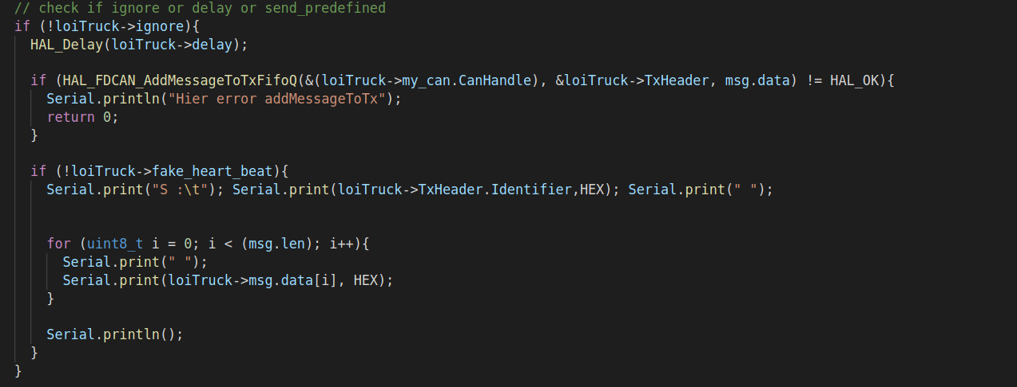
Fault Injection Implementation

Slide 23
Implementation Approach
- Programming using HAL API for:
  Ease of use
  HAL driver available for all peripheral and board independent
  Offer adequate controlling functionalities over the peripheral
- Designs:
  M7 control CAN Bus simulation and all used Peripherals: RTC, FDCAN, TIMER...
  M4 run only in Fault Injection Function need a parallel running method to manipulate data saved in SRAM
  Specialization enable further development (internet connection, print TRACE... )

Slide 24
References
1. Description of STM32H7 HAL and low-layer drivers at https://www.st.com/resource/en/user_manual/dm00392525-description-of-stm32h7-hal-and-lowlayer-drivers-stmicroelectronics.pdf
2. STM32H747xI datasheet at https://www.st.com/resource/en/datasheet/stm32h747xi.pdf
3. RM0399 Reference Manual at
https://www.st.com/resource/en/reference_manual/dm00176879-stm32h745-755-and-stm32h747-757-advanced-arm-based-32-bit-mcus-stmicroelectronics.pdf

